Slide 1

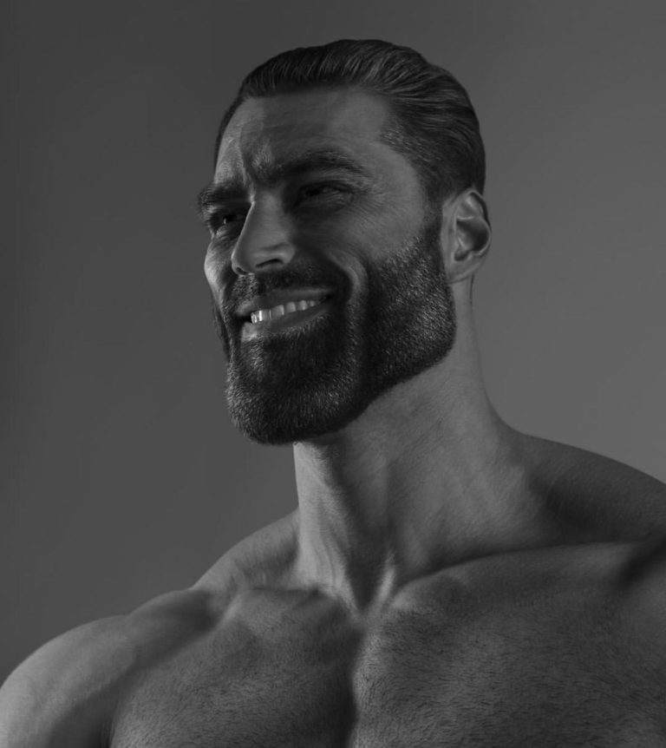
SHEHPER JILANI
A Glimpse into the glorious life of

Slide 2
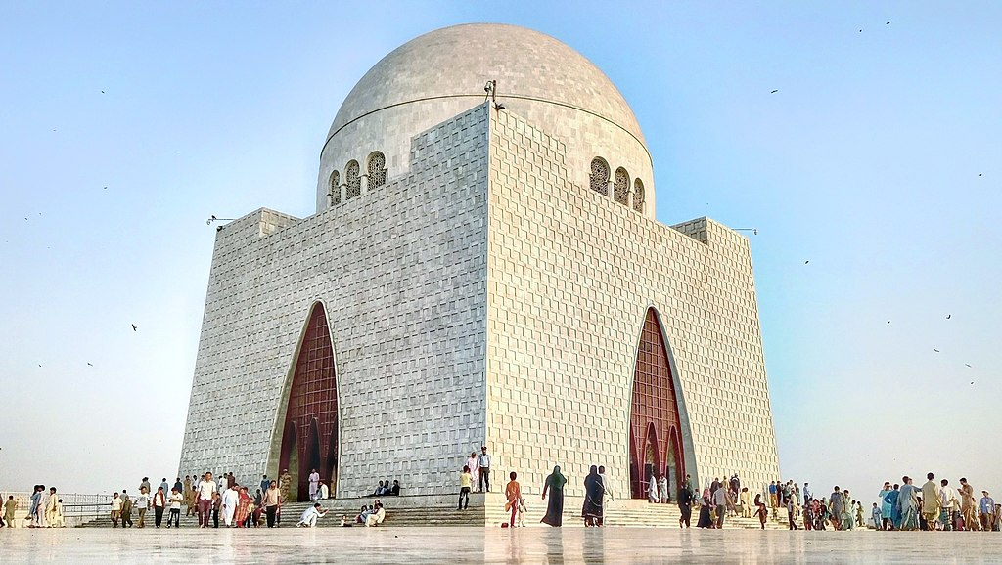

I was born in Karachi, but have live in Muscat, Oman my entire life.

Slide 3
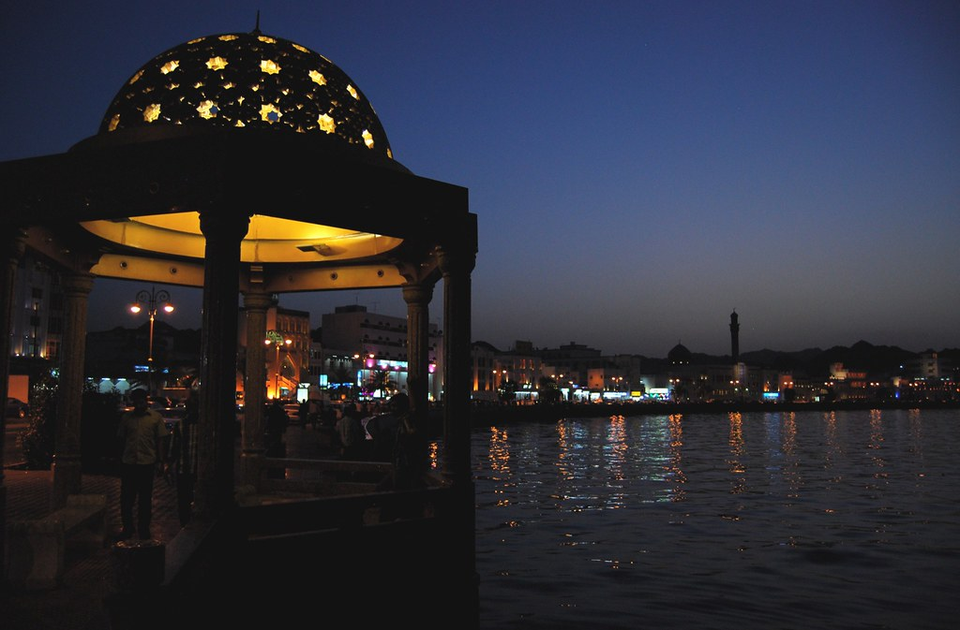
Despite being a Pakistani, this is the place I call my home.

Slide 4
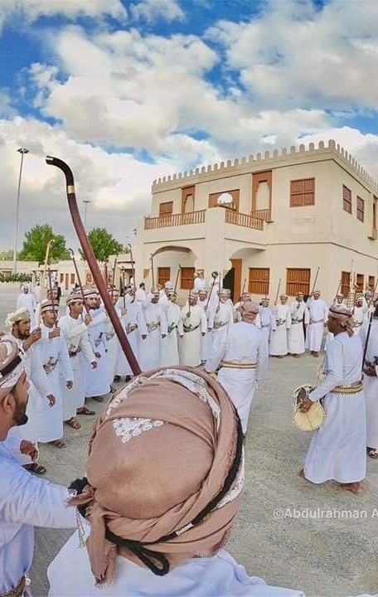
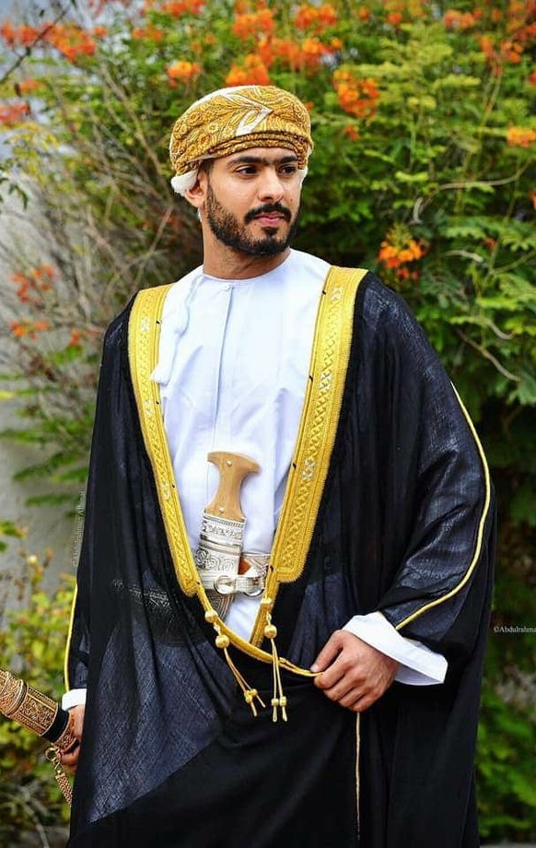
I have not only been introduced to a new culture, but also have learned their traditions and ways.

Slide 5
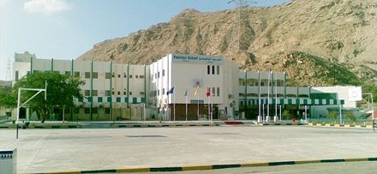
This was my School where I topped many exams, failed many. Made many friends, lost many, and spent virtually the Majority of my Life Before University

Slide 6
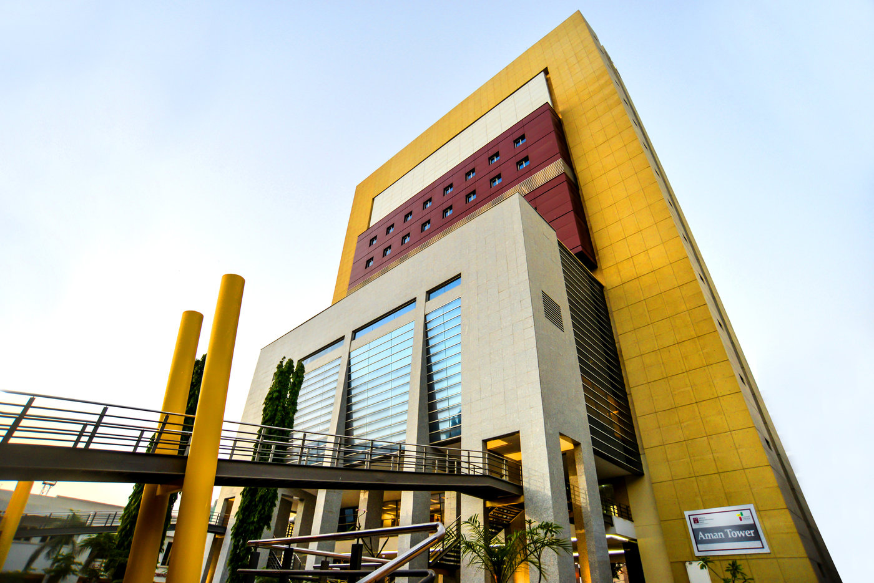
This is where I currently study. I’m doing my undergrad in BBA from here.

Slide 7
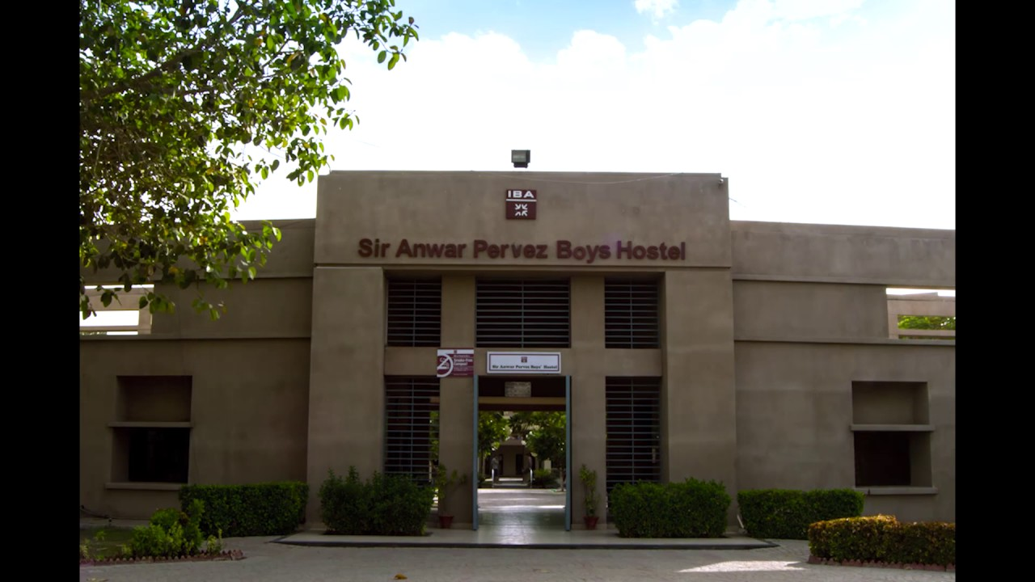
This is my current home.
Not only have I met people from all corners of Pakistan, but I have also learned so much while living alone away from my family.
The experiences that I’ve had so far and the memories I’ll make will remain with me for the rest of my life.

Slide 8
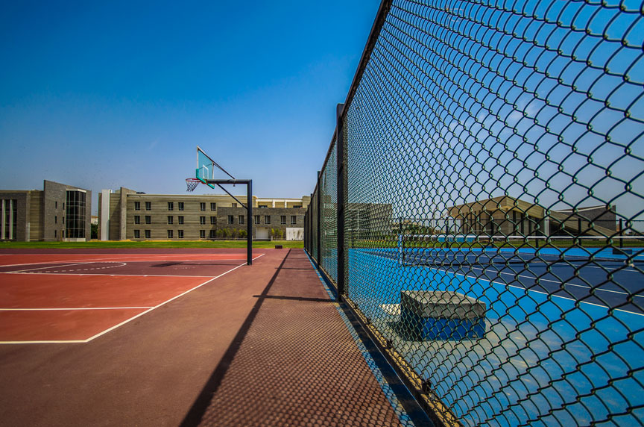
This is where I spend most of my free time with my friends talking about outr similarities and life in general.

Slide 9


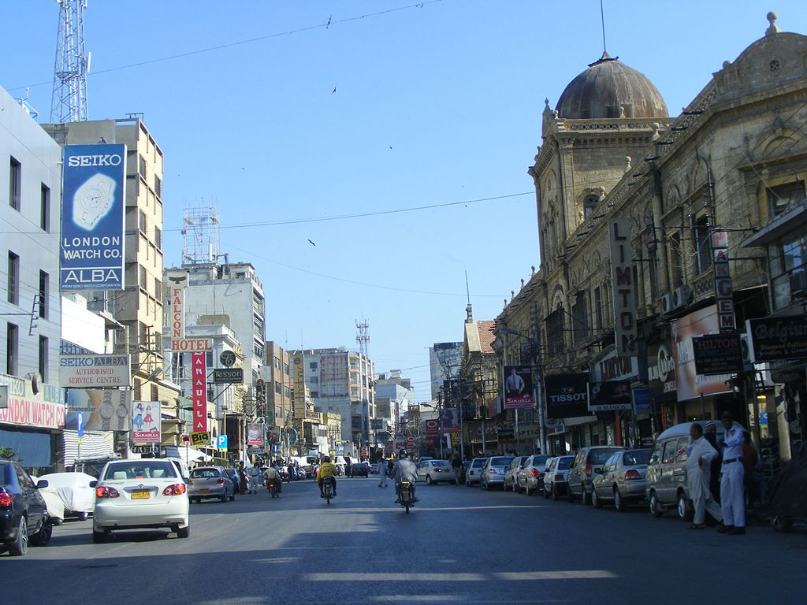

Adjusting to life in Karachi has been rather difficult. The people, lifestyle, city life, food, everything is novel to me and will take a while to get used to.
It’s hard not to feel homesick and miss my family and friends every now and then.
This Photo by Unknown Author is licensed under CC BY-SA

Slide 10

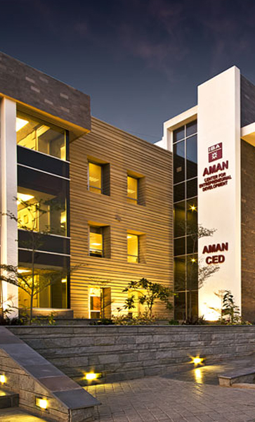
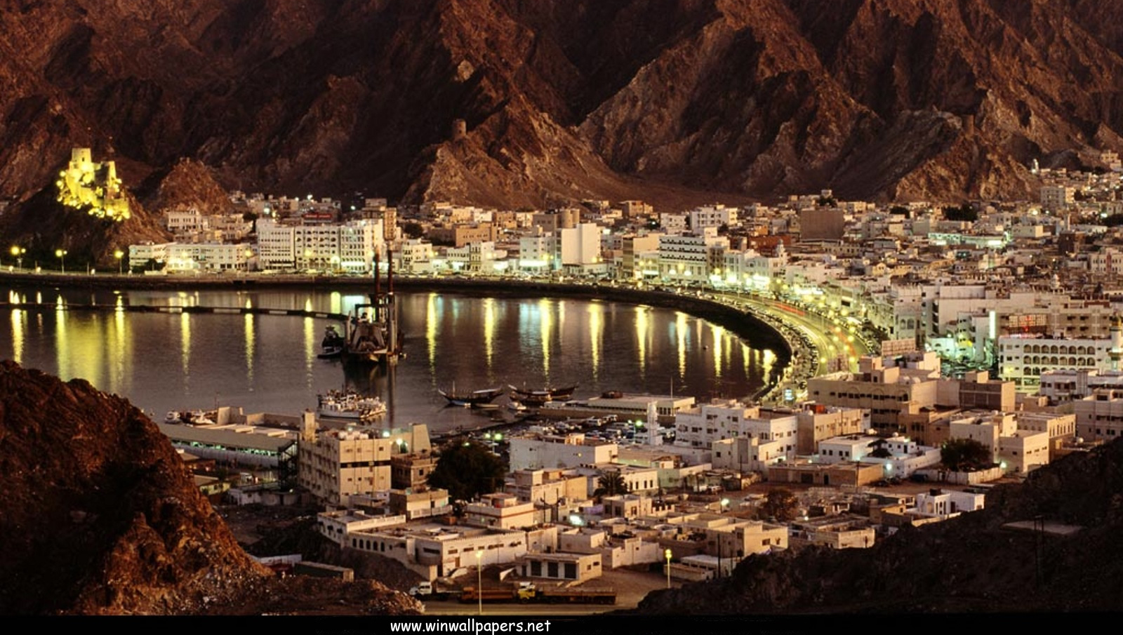
While the next 4 years will be some of the most challenging, they will also provide me with multiple opportunities and various learning curves.
This Photo by Unknown Author is licensed under CC BY-NC

